Slide 1
Week 1: INTRODUCING SCRATCH

Slide 2
Introduction
Name
School
Favorite thing you’ve done so far this summer (or looking forward to do)
Notes:
Introduce instructors

Slide 3
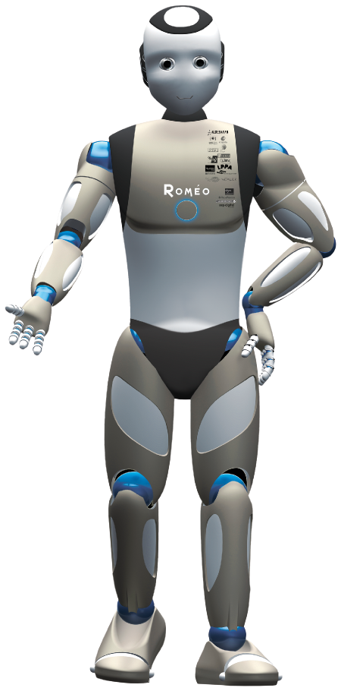
Program the robot
In pairs, assign one student to be A and the other B
For 3 minutes, A will give verbal “commands” to move or do actions, and B will act them out, or execute them
Switch roles!

Slide 4
scratch
Scratch is a coding language with a visual interface
Allows students to create projects such as stories, games, animations, and more!
Notes:
Engage students – raise hand if they have heard of or used scratch before
Sample projects:
Flappy bird:
https://scratch.mit.edu/projects/1175373249/
Flame:
https://scratch.mit.edu/projects/1125016694/
Story:
https://scratch.mit.edu/projects/1169824272/

Slide 5
Creating scratch accounts
1. Go to scratch.mit.edu
2. Join Scratch
3. Create a username and password – WRITE THEM DOWN
4. Select country – United States of America
5. Enter your birth year and month
6. Select gender (or prefer not to say)
7. Enter email address – if you don’t have one, let us know!
Notes:
Remind students to only use their own email addresses if they have them open on their laptop (or can open them).

Slide 6
EXPLORING SCRATCH
Getting Started with Scratch
Spend 10 minutes exploring Scratch and playing around with projects!

Slide 7
Basic commands
Notes:
Talk about how blocks connect to each other so that they execute one after another
Have to be connected to a ‘on click’ or ‘green flag’ block in order to actually execute
Screen share with a sample project and show what some things do
Go over simple basic commands, they can explore the rest later

Slide 8
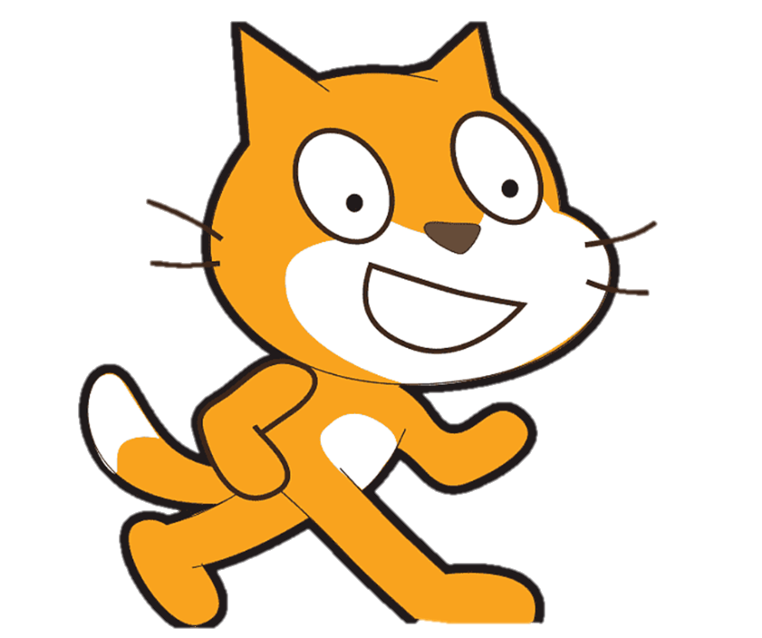
Create a sprite
Creating a Sprite
What are the different options when making a sprite?
Try choosing one, and then try drawing your own sprite!
Notes:
Show demo, and show that you can also choose an existing sprite
Also show that each sprite has its own set of commands

Slide 9

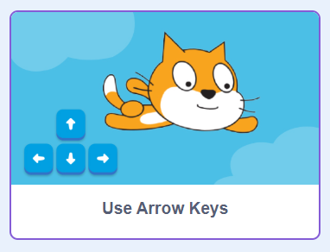
MAKE THE SPRITE MOVE
Click “tutorials” at the top of the screen.
Click the “use arrow keys” tutorial.
Notes:
Show demo, and show that you can also choose an existing sprite
Also show that each sprite has its own set of commands

Slide 10
Create a background
Creating a Background
Trying creating your own background!
If you finish early, add sprites to your background!
Notes:
Show demo, and show that you can also choose an existing sprite

Slide 11
Animated Name
Make a new project.
Use sprites for each letter of your name (in the letters category)
Example: https://scratch.mit.edu/projects/1197095557
You can make them all move around when the green flag is clicked OR make them do things when you click them.
Ideas for animations:
Spinning around!
Going up and down!
Changing color!
Increasing and decreasing size!
Changing backdrop!
Notes:
Ask if everyone has been able to make a new project. https://scratch.mit.edu/projects/1197095557

Slide 12
Break
20 minutes
Notes:
Poison dartfrog
Sharks and minows
Tag/freeze tag
Night in the museum

Slide 13
CREATE A MAZE!
Maze Starter on Scratch
Let’s look at the code inside this project.
Let’s make our own maze!
Notes:
Screen share with project and ask them what the code does

Slide 14
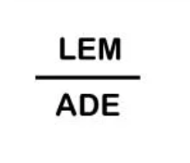
REBUS PUZZLES!
A rebus puzzle is a puzzle with both pictures and letters that means a word or phrase.
Here is an example:
Answer: lemonade!

Slide 15

MORE REBUS PUZZLES
π
Answer: apple pie!
Who knows what this symbol means?

Slide 16

MORE REBUS PUZZLES
Answer: water!

Slide 17

MORE REBUS PUZZLES
Answer: forty-two years!

Slide 18

MORE REBUS PUZZLES
Answer: broken promise!

Slide 19

Dance Party
Create an animation that resembles a ‘Dance Party’
Example: https://scratch.mit.edu/projects/1105113583
Can work independently on in pairs
Remix the project
Add a sprite
Use “switch costume” and “go to this position” and “wait _ seconds” to make it dance!
Notes:
Screen share the project, click “see inside” and explore a bit

Slide 20
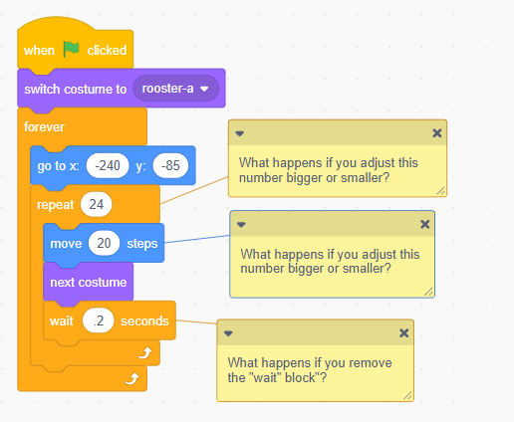

MAKING A SPRITE “WALK”
Walk Cycle on Scratch
Remix the project
Click “choose a sprite”
Select a sprite that looks like it is walking/flying
Add the sprite
Recreate this code → and experiment with the numbers!
Notes:
Screen share the project, click “see inside” and explore a bit
Ask the questions about the code and then change it with the kids to see what happens

Slide 21
Reflect and journal

